Slide 1
Block in a Blockchain,Transactions,Distributed Consensus

Slide 2
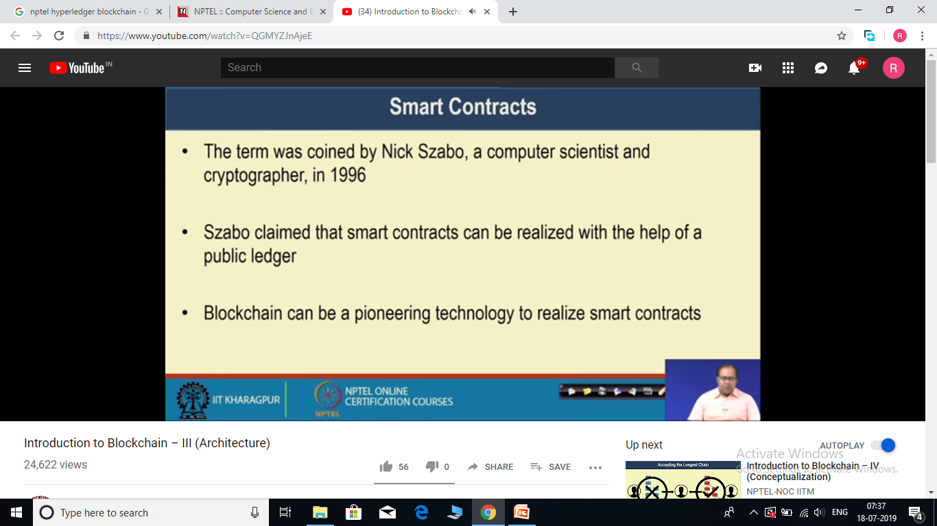

Slide 3
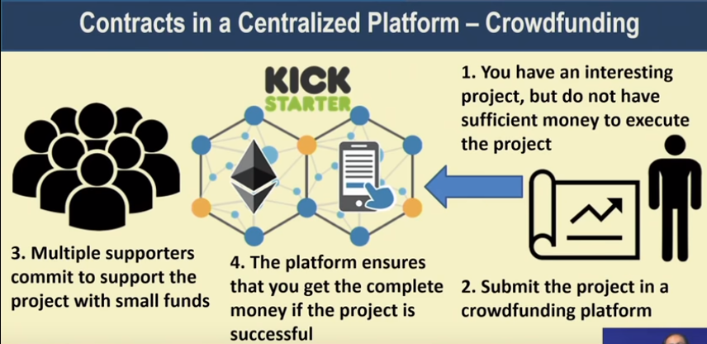
Consider the above case of crowd funding platform (Kick Starter Company) in centralized platform.
If project gets successful, centralized Kick Starter company release the fund to you. If for some reason project scarp in between, you will not get money and money will send back to supporters.

Slide 4
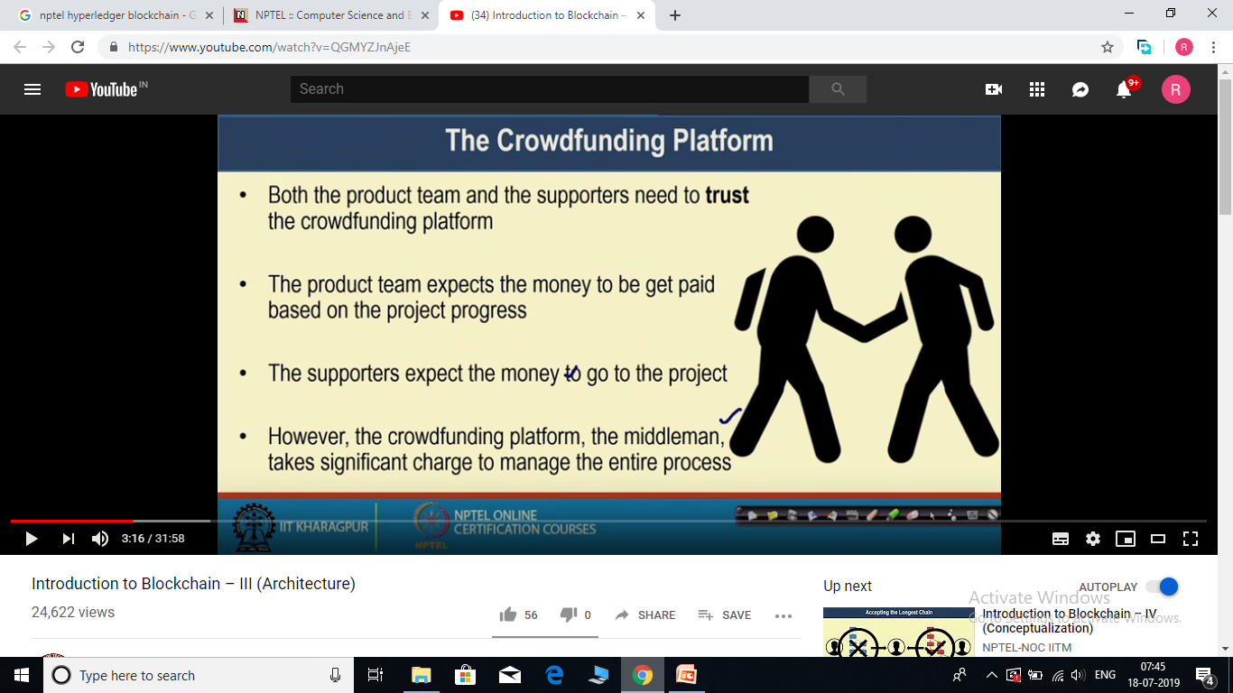
Problem with this approach-
The crowd funding platform charges significantly for managing the risk involve in entire process. Like they need to ensure that product team gets funded if projects gets successful, manage supporters (like someone do not want to support further and wants his money back etc.)

Slide 5
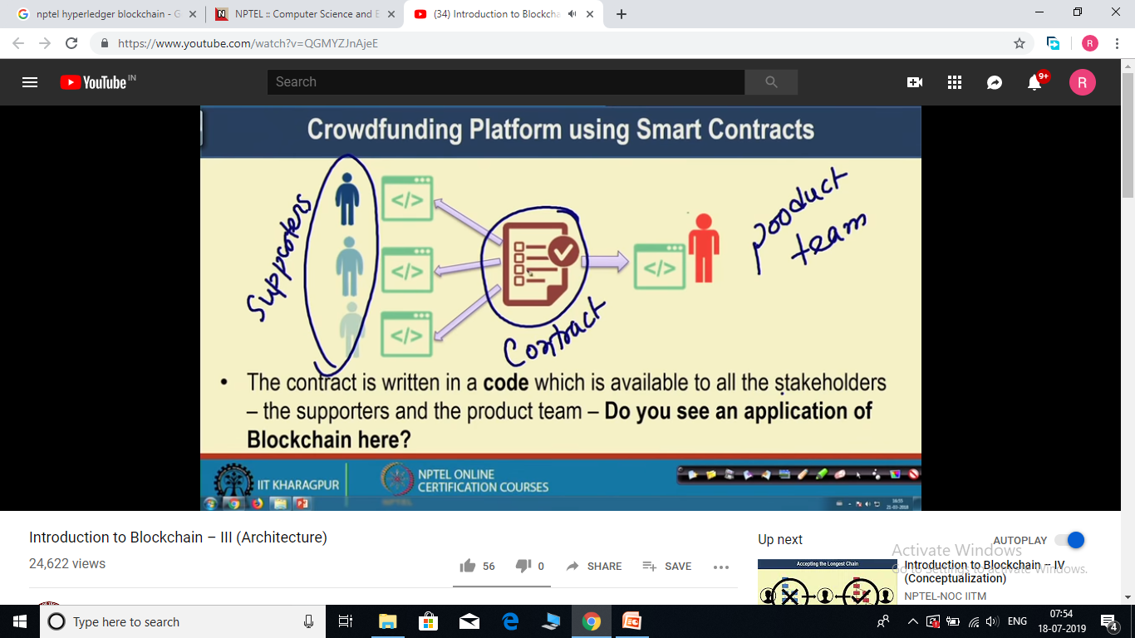
In case of blockchain network, the contract can be made available to all parties involve, everyone can verify the contract , but no one will be able to tamper it.
And thus we do not need any middleman in between.

Slide 6
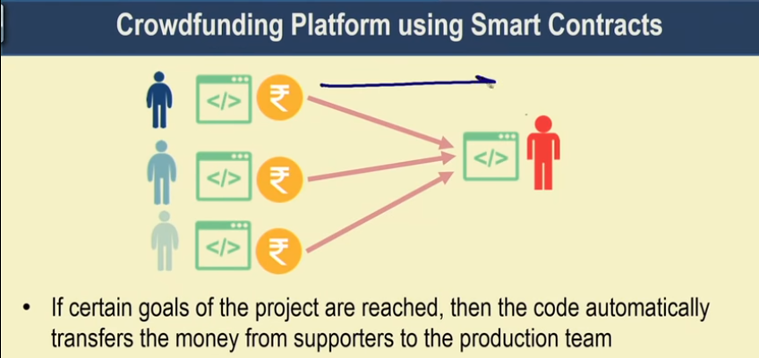
Lets suppose that after 10 days you have met some goal of the project, the smart contract (code) will automatically transfer money from supporters to product team based on whatever conditions written in contract.
Now lets suppose that after 50 days product team says that we are not able to make sufficient progress in project and project get scraped in between, Again smart contract transfer the money from product team to supports.

Slide 7
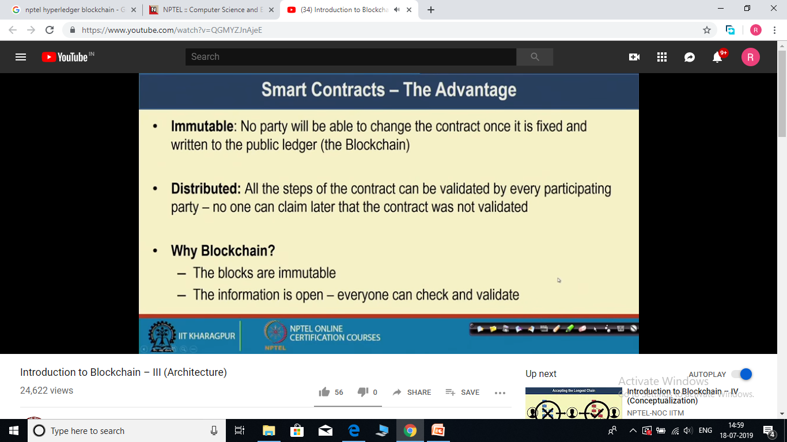

Slide 8
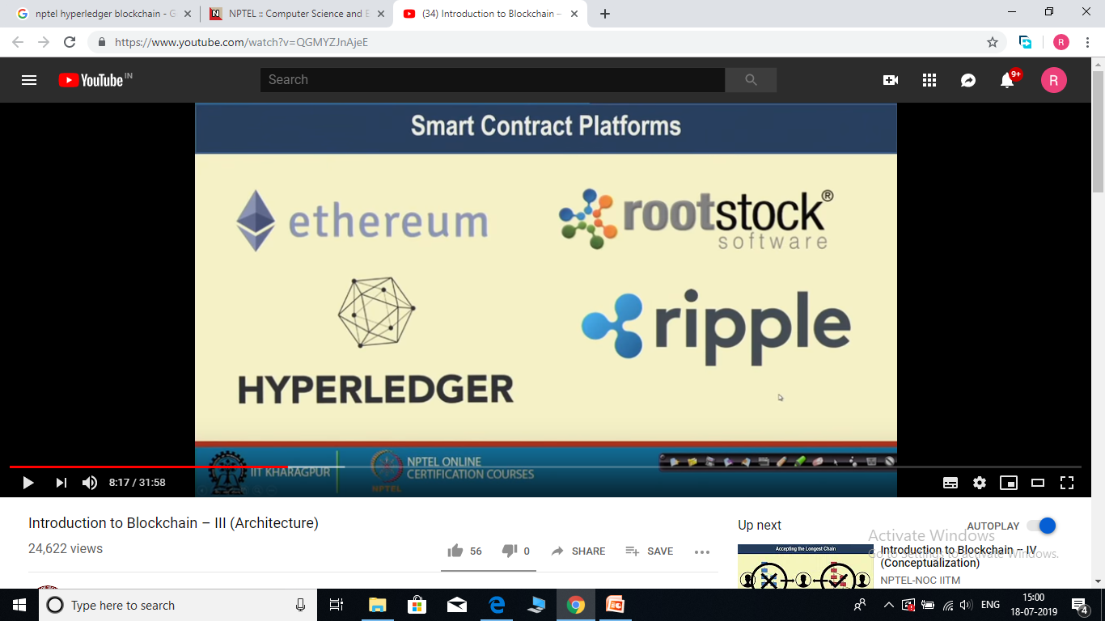
Blockchain platforms

Slide 9
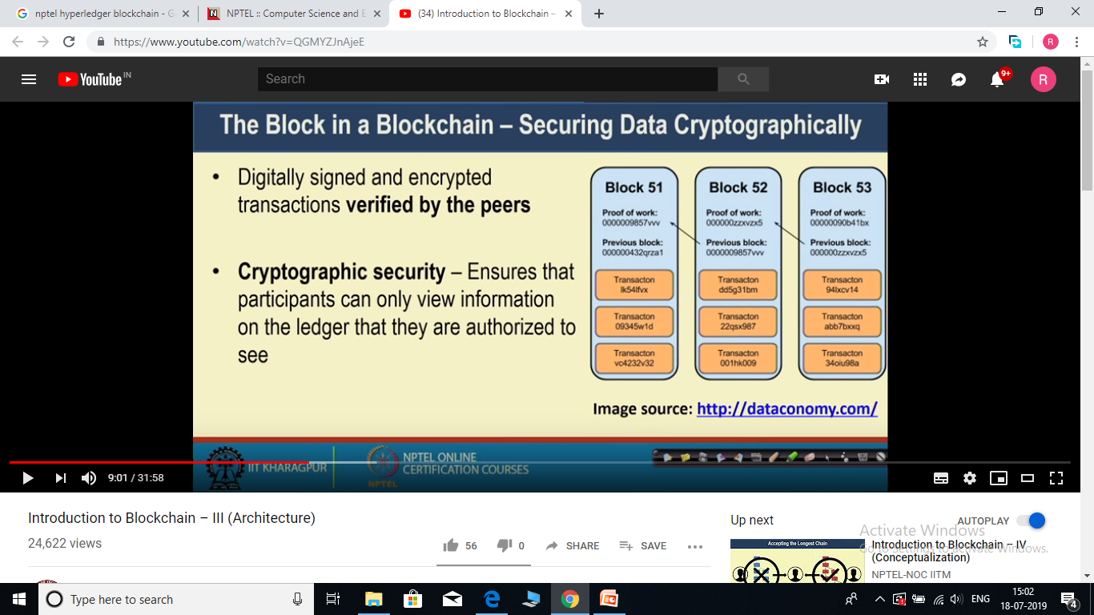
What is inside the block? And how blocks get connected in block chain?

Slide 10
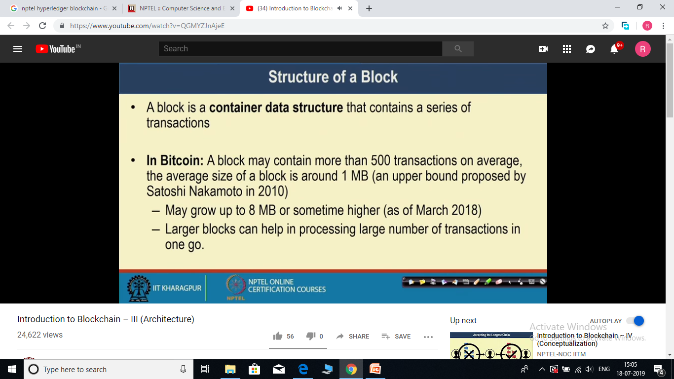

Slide 11
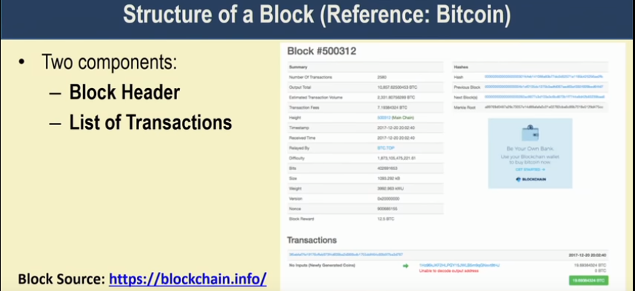
Each block has a Block header and a list of transactions as shown above.
Go to https://www.blockchain.com/explorer to see the bitcoin block structure.

Slide 12
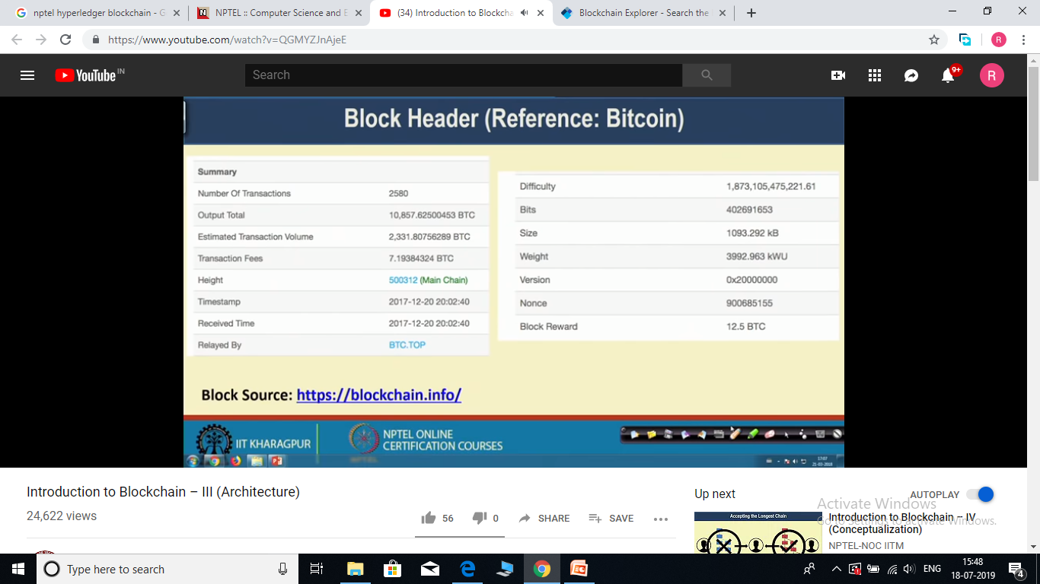
No of Transactions → Number of transaction in a block.
Output total + Estimated transaction volume→ total amount of bitcoin that have been transferred.
Transaction Fee → Fee taken by bitcoin network.
Height → The 1st block has no 1, second block has no 2 and so on... 500312 is the sequence no of this block.
Timesatmp and Recevid Time →
Relayed By → BTC TOP is the minor who has mined (validated) this block.
Difficulty → Difficulty level to find the value of hash.
Bits and size→ how many bits in the block and size in Kb
Weight → is used to balance the size of different blocks in the network.
Version → Bitcoin architecture version
Nonce → nonce used to generate Hash. This nonce find by BTC TOP miner.
Block Reward → Bitcoin, miner earned by mining this block.

Slide 13
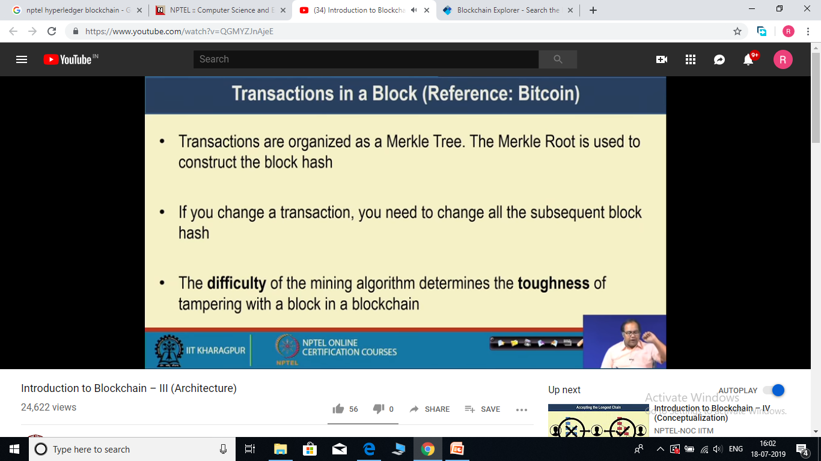
Transaction in a Block

Slide 14
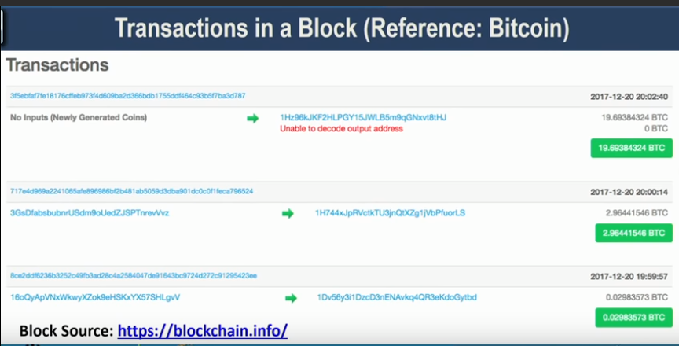
At the top of each transaction we have the hash of that particular transaction.
Left one is the sender and right one is the receiver of bitcoin and in green label is the bitcoin transferred.
Note that actual names of sender and receiver are not there, some unique ids are used to denote sender and receiver.

Slide 15
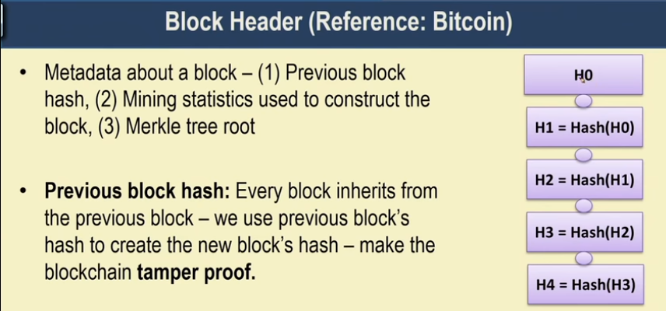
Block Header

Slide 16
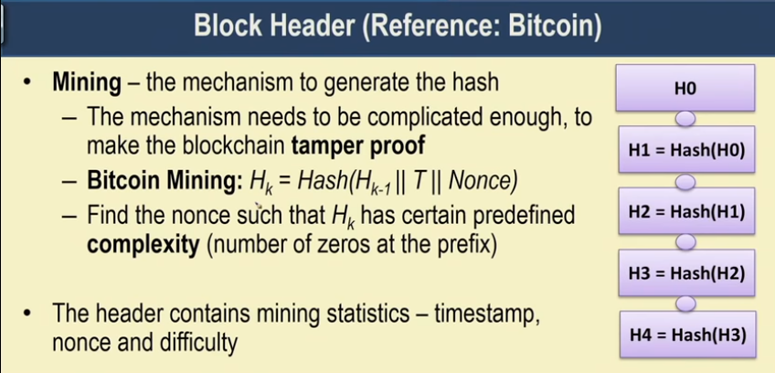
Bitcoin uses a hash like function as shown above,
Where H (k-1) – is the previous block hash
T – set of transaction in that particular block
Nonce – a random value.
The task of the miner is to find such value of Nonce that they can ensure certain difficulty in the generated H(k) value. For example H(k) should have 20 zeros at the beginning. So Miner will use the different values of Nonce until required complexity reached.

Slide 17
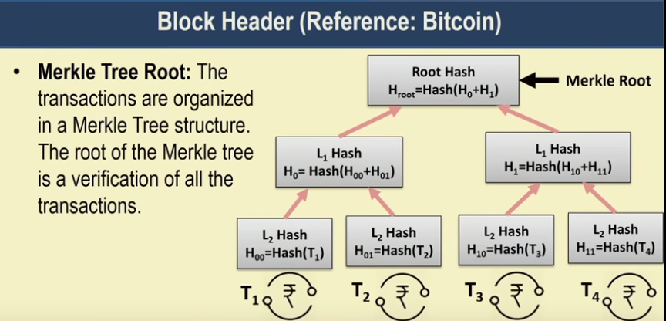
If someone make a change in T2 transaction then that causes change in the hash of H0 -→ Hroot, and if hash of root change that causes hash of every subsequent blocks change. That makes it a tamper proof data structure.

Slide 18
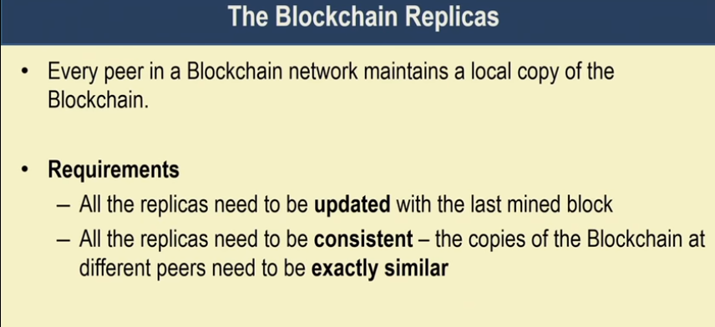

Slide 19
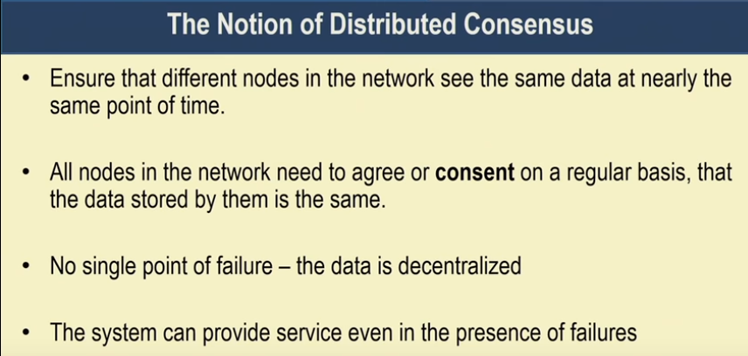
Consensus algorithm ensures the above properties.

Slide 20
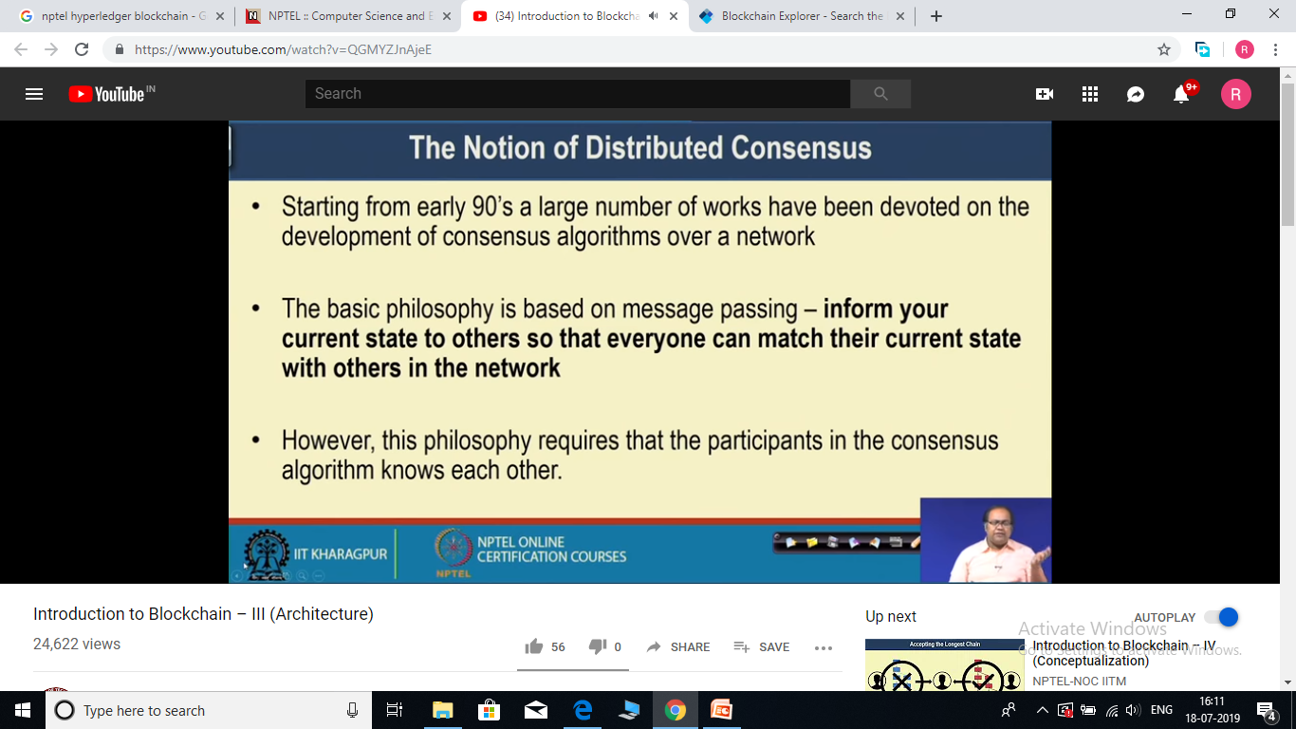

Slide 21
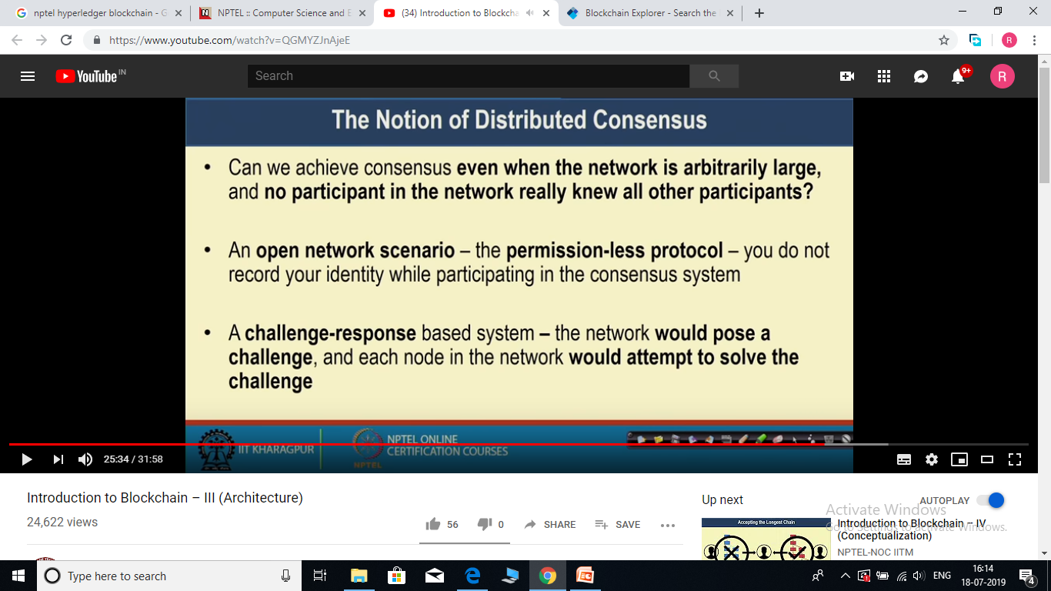

Slide 22
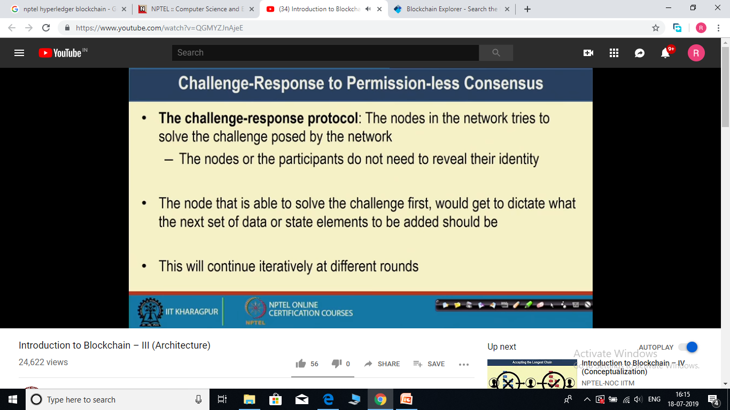
Network will pose the different challenge at different rounds. And any node that is able to solve the challenge can say that i am able to solve this particular challenge and this block is the valid block, please add this block in the current blockchain.
And this idea is know as Proof of work algorithm.
Challenge are designed in such a way that at different round different nodes would be able to solve it, so that no single node would control the network.

Slide 23
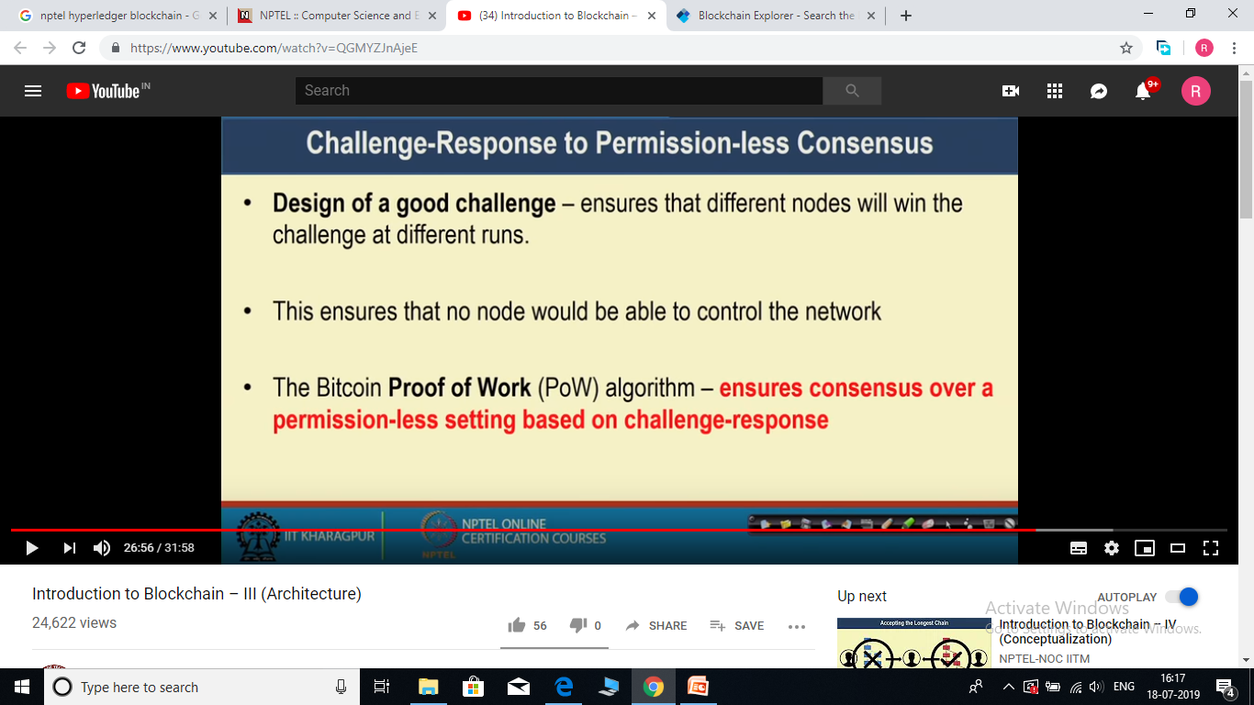

Slide 24
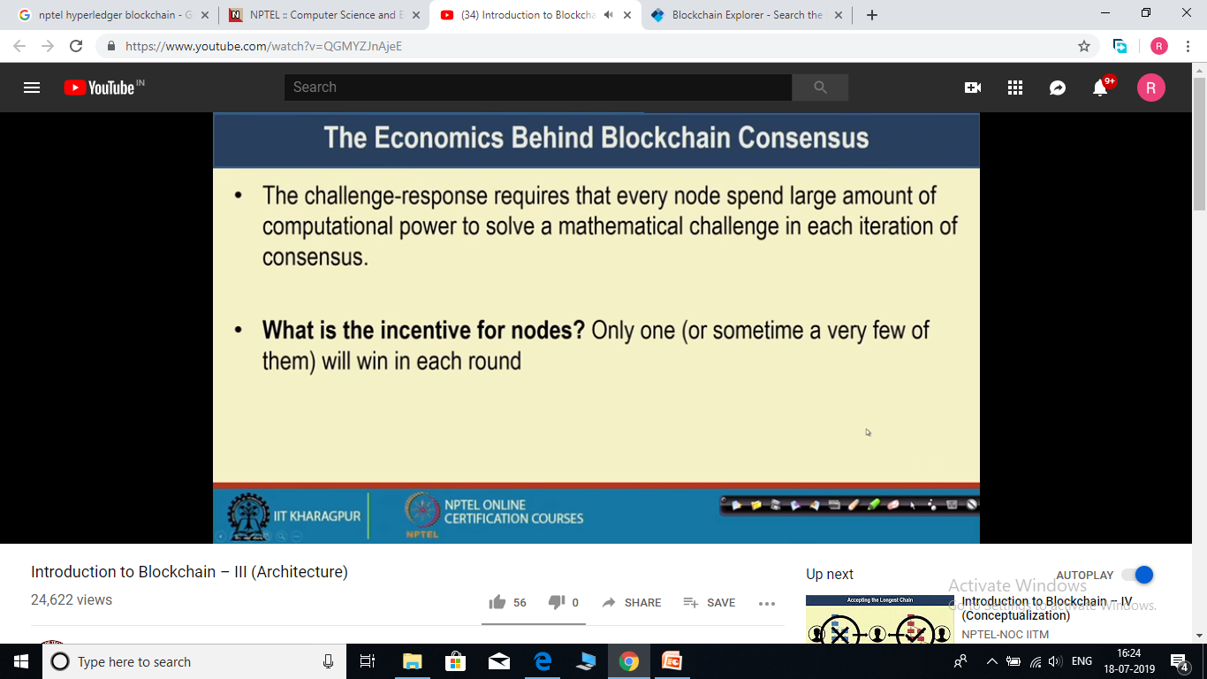
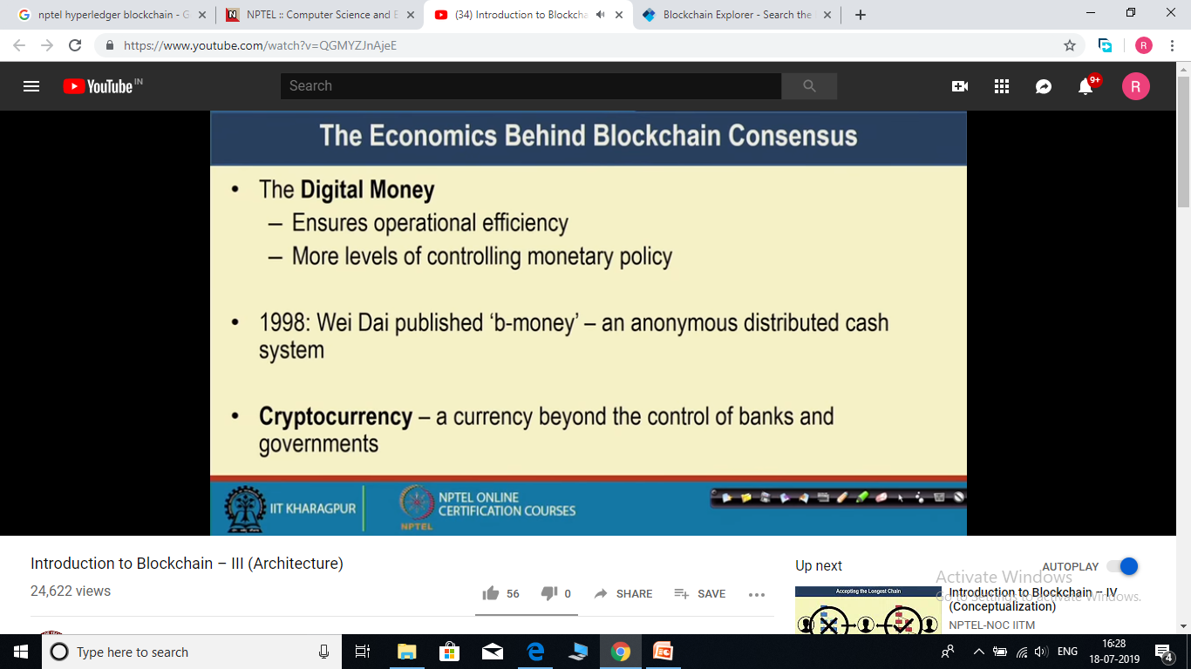

Slide 25
